Slide 1
INTRODUCTION
UNIT 1

Slide 2
DEFINITION
A database is a collection of related data.
By data, we mean known facts that can be recorded and that have implicit meaning.
A database management system (DBMS) is a collection of programs that enables users to create and maintain a database.
The DBMS is a general-purpose software system that facilitates the processes of defining, constructing, manipulating, and sharing databases among various users and applications.

Slide 3
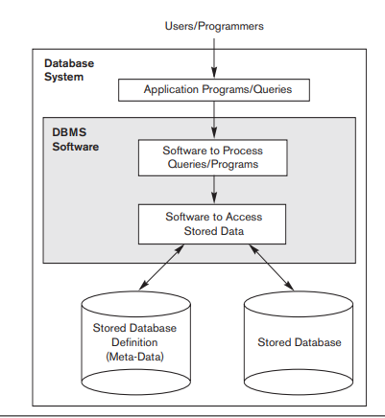

Slide 4
CHARECTERISTICS OF DATABASE
Self-describing nature of a database system
Insulation between programs and data, and data abstraction
Support of multiple views of the data
Sharing of data and multiuser transaction processing

Slide 5
1. Self-Describing Nature of a Database System
A fundamental characteristic of the database approach is that the database system contains not only the database itself but also a complete definition or description of the database structure and constraints.
This definition is stored in the DBMS catalog, which contains information such as the structure of each file, the type and storage format of each data item, and various constraints on the data

Slide 6
CONTND..
The catalog is used by the DBMS software and also by database users who need information about the database structure.
A general-purpose DBMS software package is not written for a specific database application.
Therefore, it must refer to the catalog to know the structure of the files in a specific database, such as the type and format of data it will access

Slide 7
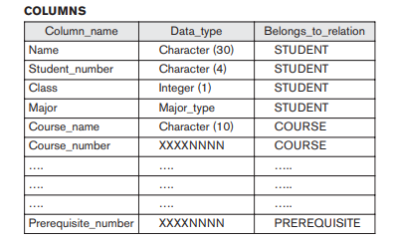
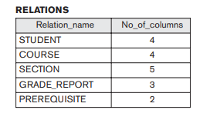

Slide 8
2. Insulation between Programs and Data, and Data Abstraction
In traditional file processing, the structure of data files is embedded in the application programs, so any changes to the structure of a file may require changing all programs that access that file.
By contrast, DBMS access programs do not require such changes in most cases.
The structure of data files is stored in the DBMS catalog separately from the access programs.
We call this property program-data independence

Slide 9
CONTND..
In some types of database systems, such as object-oriented and object-relational systems users can define operations on data as part of the database definitions.
An operation (also called a function or method) is specified in two parts.
The interface (or signature) of an operation includes the operation name and the data types of its arguments (or parameters).

Slide 10
CONTND..
The implementation (or method) of the operation is specified separately and can be changed without affecting the interface.
This may be termed program-operation independence.
The characteristic that allows program-data independence and program-operation independence is called data abstraction.

Slide 11
3. Support of Multiple Views of the Data
A database typically has many users, each of whom may require a different perspective or view of the database.
A view may be a subset of the database or it may contain virtual data that is derived from the database files but is not explicitly stored.
Some users may not need to be aware of whether the data they refer to is stored or derived.

Slide 12
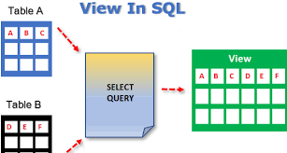
Example

Slide 13
4. Sharing of Data and Multiuser Transaction Processing
A multiuser DBMS, as its name implies, must allow multiple users to access the database at the same time.
The DBMS must include concurrency control software to ensure that several users trying to update the same data at a time.
The concept of a transaction has become central to many database applications.
A transaction is an executing program or process that includes one or more database accesses, such as reading or updating of database records the result of the updates is correct

Slide 14
DATA MODEL,SCHEMAS AND INSTANCES

Slide 15
Introduction
One fundamental characteristic of the database approach is that it provides some level of data abstraction.
Data abstraction generally refers to the suppression of details of data organization and storage, and the highlighting of the essential features for an improved understanding of data.
One of the main characteristics of the database approach is to support data abstraction.
A data model—a collection of concepts that can be used to describe the structure of a database—provides the necessary means to achieve this abstraction

Slide 16
Categories of Data Model
High-level or conceptual data models
Low-level or physical data models
Representational (or implementation) data models

Slide 17
High-level or conceptual data models
They provide concepts that are close to the way many users perceive data.
Conceptual data models use concepts such as entities, attributes, and relationship
An entity represents a real-world object or concept, such as an employee or a project from the miniworld that is described in the database.
An attribute represents some property of interest that further describes an entity, such as the employee’s name or salary.
A relationship among two or more entities represents an association among the entities

Slide 18
Low-level or physical data models
low-level or physical data models provide concepts that describe the details of how data is stored.

Slide 19
Representational or implementation data models
Representational or implementation data models are the models used most frequently in traditional commercial DBMSs.
These include the widely used relational data model, as well as the so-called legacy data models—the network and hierarchical models

Slide 20
Schemas, Instances, and Database State

Slide 21
Introduction
In any data model, it is important to distinguish between the description of the database and the database itself.
The description of a database is called the database schema.

Slide 22



schema diagram

Slide 23
Database State
When we define a new database, we specify its database schema only to the DBMS.
At this point, the corresponding database state is the empty state with no data.
We get the initial state of the database when the database is first populated or loaded with the initial data.

Slide 24
CONTND..
From then on, every time an update operation is applied to the database, we get another database state.
At any point in time, the database has a current state.
The DBMS is partly responsible for ensuring that every state of the database is a valid state
The schema is sometimes called the intension, and a database state is called an extension of the schema

Slide 25
The Three-Schema Architecture

Slide 26
The Three-Schema Architecture
The goal of the three-schema architecture is to separate the user applications from the physical database.
In this architecture, schemas can be defined at the following three levels:

Slide 27
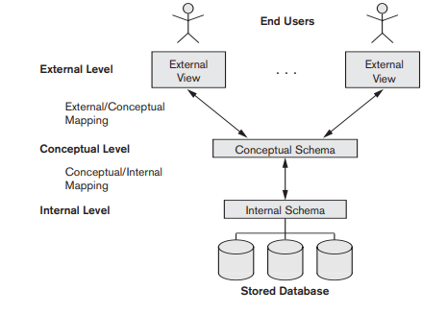

Slide 28
1. Internal level
The internal level has an internal schema, which describes the physical storage structure of the database.
The internal schema uses a physical data model and describes the complete details of data storage and access paths for the database.

Slide 29
2. Conceptual level
The conceptual level has a conceptual schema, which describes the structure of the whole database for a community of users.
The conceptual schema hides the details of physical storage structures and concentrates on describing entities, data types, relationships, user operations, and constraints.
A representational data model is used to describe the conceptual schema.

Slide 30
3. External or view level
.The external or view level includes a number of external schemas or user views.
Each external schema describes the part of the database that a particular user group is interested in and hides the rest of the database from that user group.
A representational data model is used to implement this level.

Slide 31
Data Independence and its types

Slide 32
Data Independence
The three-schema architecture can be used to further explain the concept of data independence, which can be defined as the capacity to change the schema at one level of a database system without having to change the schema at the next higher level.

Slide 33
Two Types
Logical data independence
Physical data independence

Slide 34
Logical data independence
Logical data independence is the capacity to change the conceptual schema without having to change external schemas or application programs.
We may change the conceptual schema to expand the database (by adding a record type or data item), to change constraints, or to reduce the database (by removing a record type or data item).

Slide 35
Physical data independence
Physical data independence is the capacity to change the internal schema without having to change the conceptual schema.
Hence, the external schemas need not be changed as well.
Changes to the internal schema may be needed because some physical files were reorganized for:
—for example, by creating additional access structures
—to improve the performance of retrieval or update

Slide 36
The Database System Environment
DBMS Component Modules

Slide 37
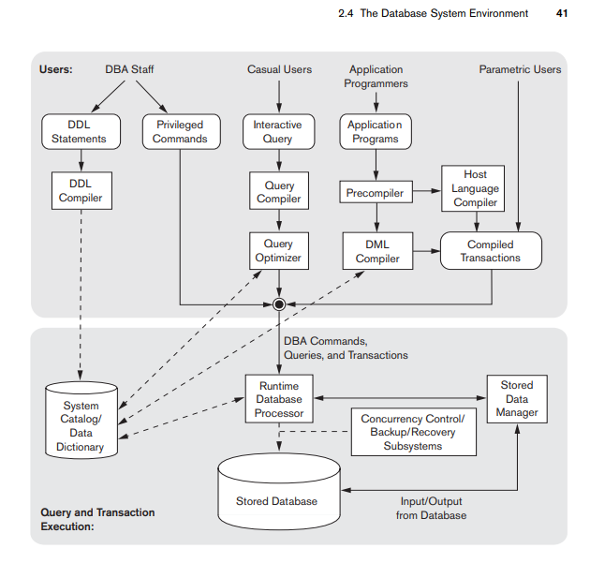

Slide 38
Explanation
The architecture is divided into two parts.
The top part of the figure refers to the various users of the database environment and their interfaces.
The lower part shows the internals of the DBMS responsible for storage of data and processing of transactions

